Slide 1
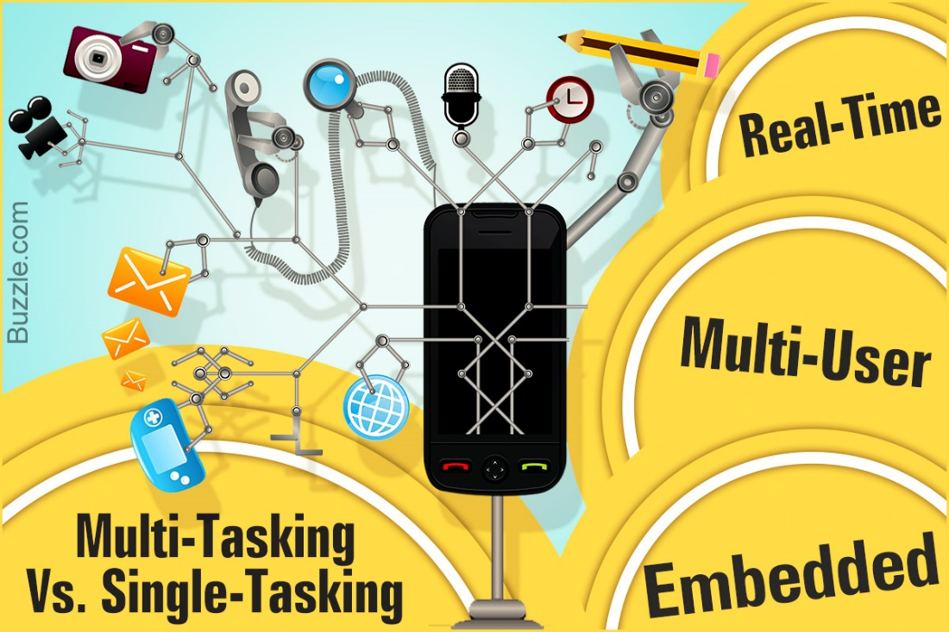
Types of Operating System

Slide 2
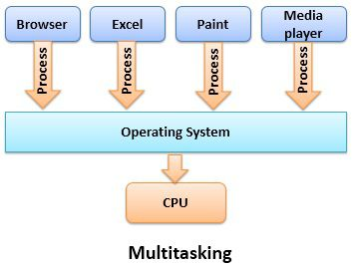
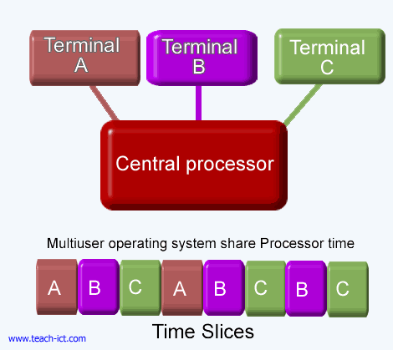
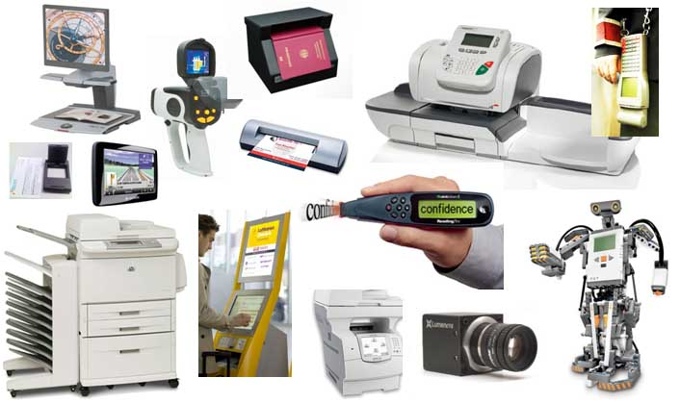
Types of Operating System
There are a number of types of operating systems.
Each is specialised for a particular purpose.
They include:
Multi-tasking
Multi-user
Embedded
Distributed
Real-time
Batch

Slide 3
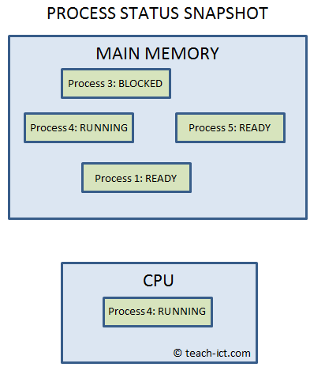
Multi-tasking OS
You are probably very familiar with this kind of operating system, as it is what runs on most personal computers.
A multi-tasking operating system allows more than one program to run at the same time - or at least they appear to run concurrently as far as the user is concerned.

Slide 4
Multi-tasking OS
A multi-tasking operating system arranges for every process in memory to run in the CPU once they are ready to do so, switching between processes from different applications to keep them all up to date.
The CPU is able to process billions of instructions per second, so this switching of processes is not apparent to the user (using scheduling).
Multi-tasking operating systems are useful because they allow users to run multiple applications at the same time.
In addition, there will be many system background tasks also running.

Slide 5
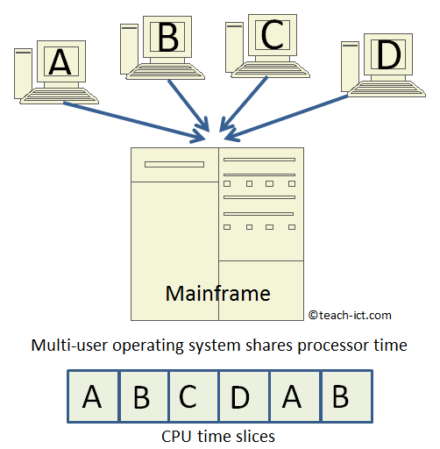
Multi-User OS
A multi-user operating system allows multiple users, on different workstations, to access a single, powerful computer via a network.
This central computer, often a mainframe or super-computer, contains the operating system which is used on all connected terminals.
The workstations are not running their own operating systems, but are controlled by a single larger one on the mainframe.

Slide 6
Multi-User OS
As you can see in the diagram, a multi-user operating system handles the needs of different users by dividing up CPU time and assigning blocks to each user in turn.
Since a computer works so quickly, these blocks are shorter than a human would notice (about a hundredth of a second).

Slide 7
Multi-User OS
A multi-user OS carries out the following tasks:
Each user logs on to the system and is presented with their workspace
Allocates resources for the jobs they want to run
Keeps logs of how much processing time and resources they use
Works out the most efficient use of computer processing cycles
Maintains security and privacy between the different users
Examples of multiuser operating systems include automated checkouts at a supermarket

Slide 8
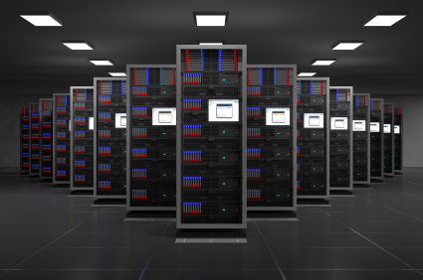
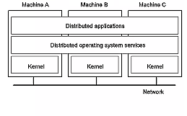
Distributed OS
A distributed operating system controls a number of computers at the same time in order to undertake a single computer-intensive task.
Each computer contains part of the overall operating system.
The group of computers is called a 'cluster'.

Slide 9
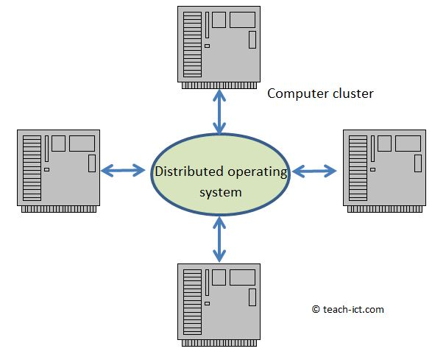
Distributed OS
Distributed computing is a form of parallel processing.
One example of distributed operating systems is using a cluster to work on scientific problems like testing new pharmaceutical drugs.
This is a task that needs supercomputer levels of power.
As far as the user is concerned they have access to a single, hugely powerful computer.
The operating system hides all the details needed to control the system.

Slide 10
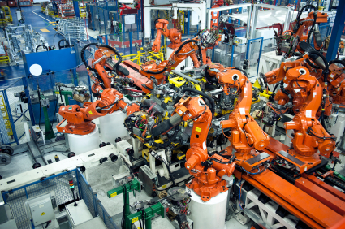
Real Time OS
A real type operating system (RTOS) is designed to handle input data within a guaranteed response time(called its latency).
RTOS are appropriate when the OS needs to be able to respond instantly to changes – data is processed immediately.
It is specifically designed to be extremely reliable and to have very precise and consistent timings.
If two inputs arrive at the same time, the RTOS programmer is able to set a priority to them, so the most important signals are handled first.

Slide 11
Real Time OS
These features make it suitable for use in:
Factory production lines where robots need to be controlled with very specific timing
Car engine management units where thousands of inputs are received per second and responses to the inputs have to be timely
The Mars Rover has a RTOS to handle all its sensor data.
A washing machine will have an RTOS to handle the wash cycle properly

Slide 12
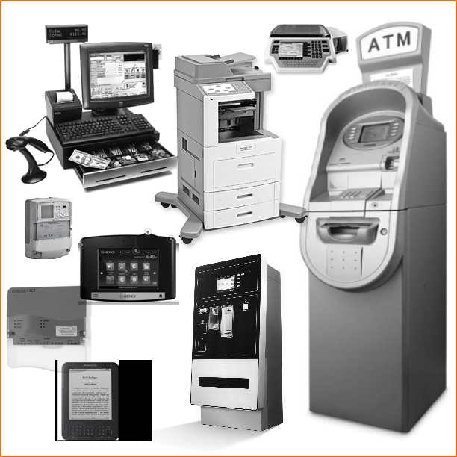
Embedded OS
Many types of electronic equipment contain a computer to control their operation e.g.
Cash machines (ATM)
Cars
Smart television
Industrial control equipment
DVD players
Satellite set top boxes
The operating system on such a computer is called an embedded operating system.

Slide 13
Embedded OS
The embedded computer hardware is designed to handle a specific task on a specific system hardware.
For example the embedded OS inside a satellite-TV set top box has a very different task to an ATM and it will be carefully coded to be as efficient as possible for the needs of that task.
An embedded operating system may need to work in real time in order to respond to its input within a set time - if so, it would be an embedded real time operating system.
Embedded operating systems do not generally multi-task as they usually have a single job to perform.

Slide 14
Batch OS
A 'batch' is the name given to the task of doing the same job over and over again, the only difference being the input data presented for each iteration of the job and perhaps the output file.
This kind of operating system requirement is common on a mainframe computer that was purchased specifically with massive repetitive data processing in mind.
E.g. a mainframe set up to process 30 million pension statements, each one calculated for a specific customer.

Slide 15
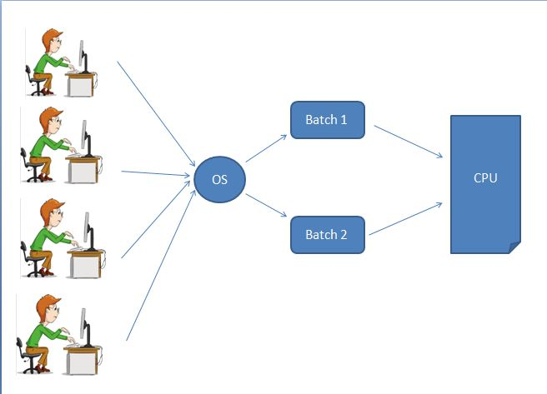
Batch OS
A batch job does not need any intervention by a person once the initial commands are set up.
Setting up a batch job is a bit like filling out a form, with specific details needing to be provided. Details include:
Job Owner
Priority of the Job (some jobs are less urgent than others)
Data file details (for input and output)

Slide 16
Batch OS
How much processor time is allowed for the job (avoids CPU hogging)
Maximum lines to be printed (avoids infinite printouts)
What to do if the job fails to run properly (e.g. create a failed jobs report)
Accounting data (to charge the Job Owner for the batch)

Slide 17
Batch OS
Batch processing is different to Real Time processing in that the data is collected first and then processed together (unlike RT where it is processed immediately)
A batch process requires separate programs for input, process and output.
This means all the input is handled first.
Then some processing is applied by a particular program.
Then a set of outputs are produced.
Real Time on the other hand requires continual input-process-output activity, as soon as an input arrives, it is processed and output.

